Slide 1

Match Mate: Revolutionising the Marriage App
Presented By
Name: Shuja-ur-Rehman Ref# L1S21BSSE0056
Name: Jawad Mughal Ref# L1S21BSSE0079
Name: Tayyab Afzaal Ref# L1S21BSSE0089

Slide 2

Introduction to Match Mate
Match Mate is a revolutionary marriage app that aims to transform the way people find partners. Our app provides a safe and secure platform for individuals to connect with potential partners. With Match Mate, you can be confident that you are interacting with genuine users, as we have implemented a document verification feature to ensure the authenticity of user information.

Slide 3

Goals and Objectives
Facilitating Genuine Connections: To create a platform that fosters authentic connections leading to meaningful and lasting marriages. Implement advanced matchmaking algorithms to enhance compatibility. Prioritize user authenticity through document verification features.
Ensuring User Security and Privacy: To establish Match Mate as a secure and private space for individuals seeking life partners. Implement robust privacy controls for user profile management. Employ end-to-end encryption for secure communication.
User-Friendly Experience: To provide an intuitive and user-friendly interface for seamless navigation and engagement. Develop an easy onboarding process for new users. Incorporate in-app guidance and tooltips for user assistance.

Slide 4

Problem statement: Lack of proper document verification in marriage apps
Marriage apps lack proper document verification, leading to potential risks for users. Without stringent verification of user-provided information, the authenticity and accuracy of profiles remain uncertain, eroding trust in matchmaking platforms. This loophole can result in misleading and deceptive experiences for users, undermining the purpose of these apps.

Slide 5

Verification of User Documents
Challenges of Verifying User Documents
Ensuring the authenticity of user information is crucial for building trust and maintaining a safe environment for users.
Verifying user documents can be challenging due to the potential for fraudulent or inaccurate information.
Balancing the need for thorough verification with user privacy and data protection is a delicate process.
Developing a robust system for document verification that is efficient, reliable, and scalable.

Slide 6
Ensuring Authenticity of User Information
Challenges in Authenticating User Information
1. Verification of Identity
2. Preventing Fake Profiles
Verifying the identity of users is essential to maintain a safe and secure environment.
Fake profiles can mislead users and compromise their safety.
Implementing measures to detect and prevent the creation of fake profiles is crucial.
This process involves validating user documents such as ID proofs, passports, and other relevant documents.
3. Ensuring Accurate User Information
4. Protecting User Privacy
Users may provide inaccurate or misleading information about themselves.
Balancing the need for authenticating user information with the importance of protecting user privacy is a challenge.
Implementing mechanisms to verify and validate user-provided information is necessary.
Implementing robust privacy measures is essential.

Slide 7
Types of documents that need to be verified:
Bio data: Personal information like name, age, and occupation
Location: Proof of residence and address
Educational qualifications: Certificates or transcripts

Slide 8
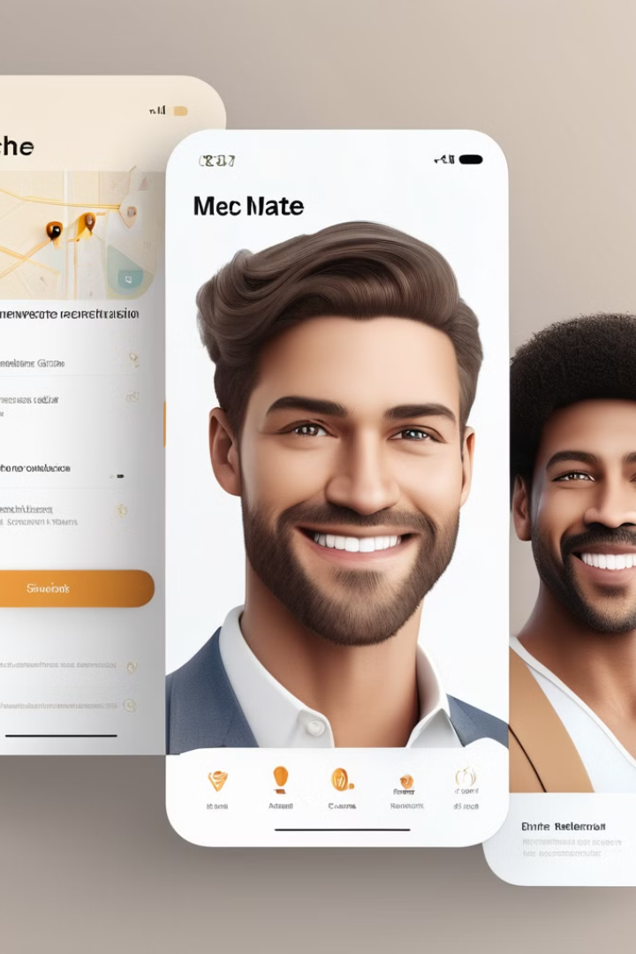
Bio data
Personal Information: Name, age, gender, and relevant personal details
Family Background: Details about family members, origin, and background
Work and Career: Employment status, occupation, and career aspirations

Slide 9
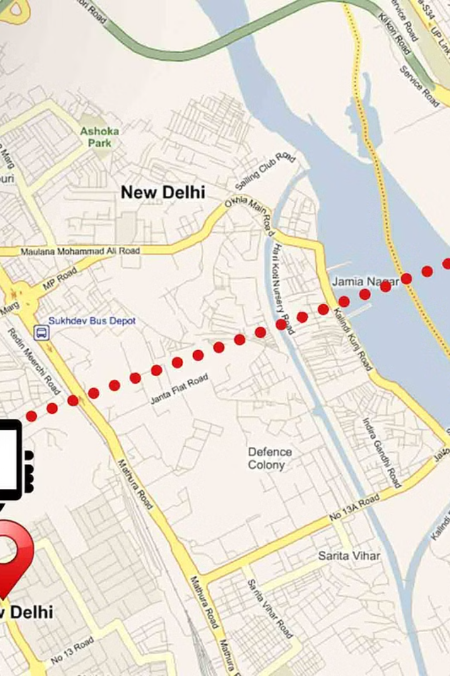
Location
Distance: Matching distance from home location
Proximity: Proximity search for potential matches
Google Location: Uses google location technology and also person have to upload the land document to verify the user's location. This ensures that users are connecting with people who are in their desired location.

Slide 10

Educational Qualifications
Academic Degrees: Verification of academic degrees and certificates
Certifications: Confirmation of any professional qualifications or certifications
Processing Efficiency
Streamlining the verification process to reduce waiting times for users.
Ensuring quick and accurate validation of documents.

Slide 11
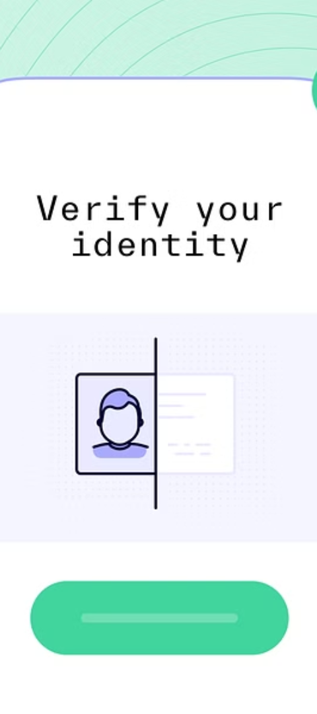
Solutions for Effective Document Verification
1
Data Encryption
Implement robust data encryption to secure sensitive personal information.
2
Automated Verification
Utilize AI and machine learning algorithms for efficient automated document verification.
3
Blockchain Technology
Explore blockchain solutions for immutable and transparent document verification processes.

Slide 12
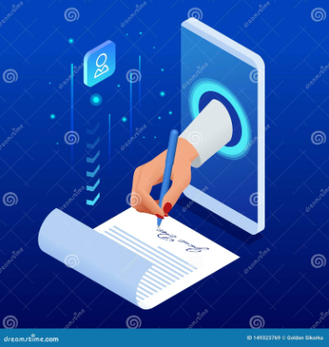


Creating a Safe and Secure Platform
Document Verification
User Privacy
Reporting & Blocking
To ensure the authenticity of user information, Match Mate allows users to verify their documents, such as IDs or passports.
Match Mate values user privacy and takes steps to protect personal information, ensuring a secure environment for users to connect with potential partners.
Match Mate provides users with the ability to report and block any suspicious or inappropriate behavior, fostering a safe and respectful community.

Slide 13
Benefits of proper document verification in marriage apps
Enhanced Security
Reduced Fraud
Verified documents ensure a safer and more trustworthy online environment.
Minimizes the risk of fraudulent profiles and deceptive information.
Increased Credibility
Improved User Experience
Boosts the credibility and authenticity of profiles for genuine connections.
Provides a peace of mind and confidence for users in their matchmaking journey.

Slide 14
Technical implementation/Tools
Frontend Development
Backend Developmenton
Database Management
Creating a responsive and user-friendly user interface using modern web technologies.
Building a robust and scalable server-side architecture to handle user data and requests.
Designing efficient database schema to store user profiles and preferences.
Implementing intuitive and interactive designs for a seamless user experience.
Implementing secure authentication and authorization mechanisms for data protection.
Implementing data integrity and reliability measures for seamless app functionality.
React Native
React
Node Js
Mongo DB

Slide 15
Conclusion
Key Points
Match Mate is a revolutionary marriage app that transforms the way people find partners.
The app includes functionality to verify user documents and ensure the authenticity of user information.
The target market includes individuals who are looking for a partner.
Match Mate provides a safe and secure environment for users to connect and build meaningful relationships.
Benefits of Match Mate
Match Mate streamlines the partner search process, saving users time and effort.
The app's document verification feature ensures that users can trust the information provided by potential partners.
Match Mate's safe and secure environment protects user privacy and provides a comfortable space for meaningful connections.
With Match Mate, users have access to a large pool of potential partners, increasing the chances of finding the perfect match.
The app's user-friendly interface and intuitive features make it easy and enjoyable to navigate and use.

Slide 16


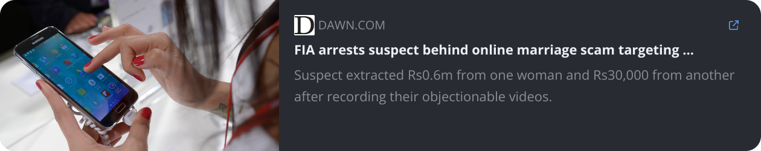
Referral Content

